Slide 1
Edit profile
Testing if i add links, can users click
and gain access to my work

Slide 2
Link added

Slide 3
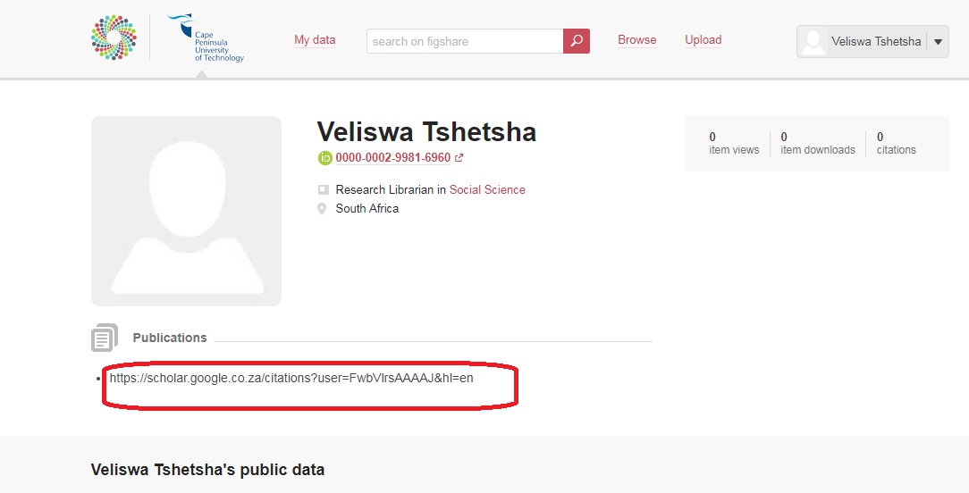
Added link not hyperlinked and is not clickable

